Slide 1

Customer Support ChatBot
FOR
E-COMMERCE
NIRMAL KUMAR P R
422521104026
prnirmalramesh04@gmail.com
University College of Engineering Villupuram

Slide 2

Outline
01
Problem Statement
02
Proposed System/Solution
03
System Requirement
04
Algorithm and Deployment
05
Who are the end-users?
06
Result
07
Conclusion
08
References

Slide 3

PROBLEM STATEMENT
The problem in eCommerce customer support is high response times and operational inefficiencies. We implemented an automated chatbot using deep learning techniques to provide real-time, consistent, and cost-effective customer support. This solution aims to enhance user experience and streamline the support process

Slide 4
PROPOSED SYSTEM/SOLUTION
Chatbot Architecture Design:
Design a chatbot architecture using LSTM networks for natural language processing, complemented by text cleaning, tokenization, and intent classification to deliver precise and relevant responses.
Deep Learning Model:
Utilizing LSTM networks to process and understand the sequential nature of natural language data effectively. This involves processing textual data and capturing long-term dependencies in sequences, facilitating the model's understanding and classification of user queries.

Slide 5
PROPOSED SYSTEM/SOLUTION
Text Preprocessing:
This involves removing unnecessary characters, converting text to lowercase, lemmatizing words, and removing stopwords to prepare the text data for model input.
Hyperparameter Tuning:
Utilize Keras Tuner to automate the optimization of model parameters to improve performance and accuracy. This involves systematically exploring the hyperparameter space to find the optimal configuration for the model.

Slide 6
PROPOSED SYSTEM/SOLUTION
Tokenization and Padding:
Implement tokenization and padding techniques to convert text data into numerical sequences and ensure a consistent input length for the model. This involves tokenizing textual data to convert words into numerical form and applying padding to ensure a uniform sequence length.

Slide 7

SYSTEM APPROACH
1.Hardware
Internet Connection: Stable and high-speed internet connection to facilitate data retrieval, model updates, and seamless interaction with external services and APIs.
RAM: Minimum of 8GB RAM to ensure smooth performance during model training and inference, accommodating the memory requirements of large datasets and complex computations.
CPU: A multicore processor to handle computational tasks efficiently, supporting the intensive processing demands of deep learning algorithms

Slide 8
SYSTEM APPROACH
2.Software
Python: Programming language used for developing the chatbot application.
NLTK: Natural Language Toolkit used for text preprocessing and tokenization.
TensorFlow/Keras: Deep learning libraries used for building and training the LSTM model.
Ju﻿pyter Notebook: Interactive computing environment used for prototyping, data analysis, and model development.
scikit-learn: Library for various machine learning tasks like data preprocessing and model evaluation.
Optional: Django for web-based interface (if applicable)

Slide 9



ALGORITHM AND DEPLOYMENT
1.Data Preparation:
Retrieved the dataset from Kaggle to serve as the basis for training and testing the chatbot model
2. Text Preprocessing:
Cleaned and organized raw text data usi﻿ng NLTK for text processing.
Removed punctuation and stopwords to ensure clean input.
Lemmatized words to reduce them to their base form
Tokenized text to convert sentences into a list of words for analysis

Slide 10
ALGORITHM AND DEPLOYMENT
3.Deep Learning Model: Networks
Impl﻿emented LSTM networks to process and understand natural language data
Employed a dense layer with 208 units followed by a softmax output layer
Utilized the Adam optimizer w﻿ith a learning rate set to 0.01
Configured the model with two LSTM layers, each having 110 units
4.Hyperparameter Tuning: Keras Tuner
Tuned the number of units in LSTM layers ranging from 50 to 150.

Slide 11
ALGORITHM AND DEPLOYMENT
Utiliz﻿ed Keras Tuner to automate the optimization of model parameters
Explored the number of dense layers in the model from 1 to 20.
Adjusted learning rates between 0.01, 0.001, and 0.0001 for optimal performance.
5. Tokenization and Padding:
Tokenized the text data using Keras Tokenizer to convert words into numerical sequences.
Applied padding to ensure a uniform sequence length of 200 for model input.

Slide 12
ALGORITHM AND DEPLOYMENT
Set the vocabulary size to 2000 to capture the most frequent words in the dataset.
Used an out-of-vocabulary token (OOV) to handle words not in the vocabulary during tokenization.

Slide 13


DEPLOYMENT
1. Jupyter Notebook:
2. Django Web Application:
The chatbot code is hosted on GitHub by implementing the main code directly on a Jupyter Notebook. This approach allows for easy viewing and execution of the code..
The chatbot is presented as a user-friendly web-based interface using the Django framework and hosted on GitHub. This method offers a seamless user experience and makes the chatbot accessible via a web browser.

Slide 14

Online Shoppers: Individuals looking for product information, recom﻿mendations, or assistance with their shopping experience
Technical Support: IT professionals or developers involved in maintaining and updating the chatbot's functionality and performance
WHO ARE THE EN﻿D USERS?
Website Visitors: Potential customers exploring the eCommerce website whomay have questions or require assistan﻿ce.
Customer Support Teams: Staff members responsible for handling customer queries and providing timely and accurate responses.

Slide 15
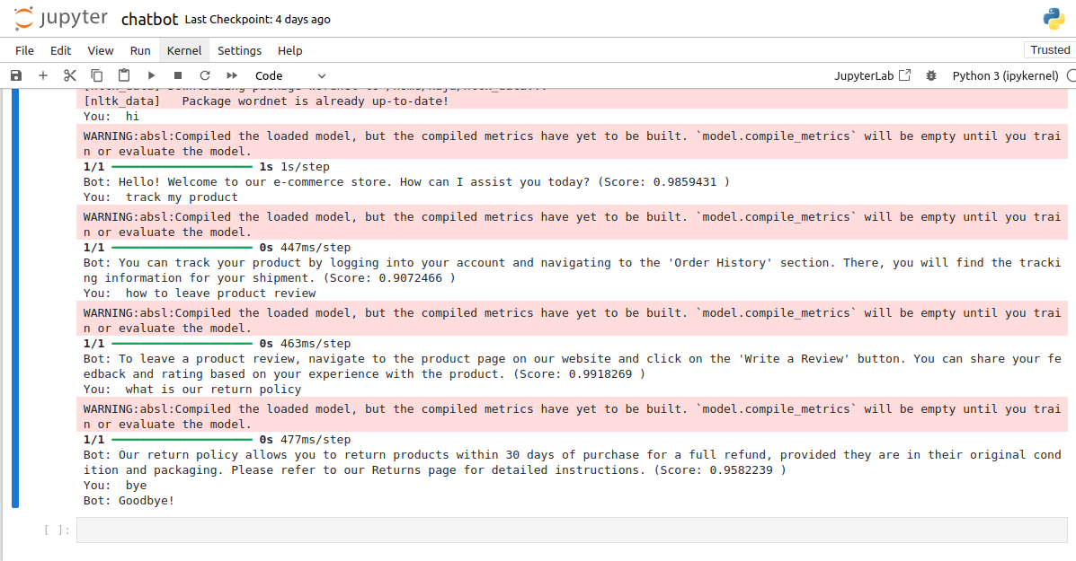
RESULT
RESULT
Executed on Jupyter

Slide 16
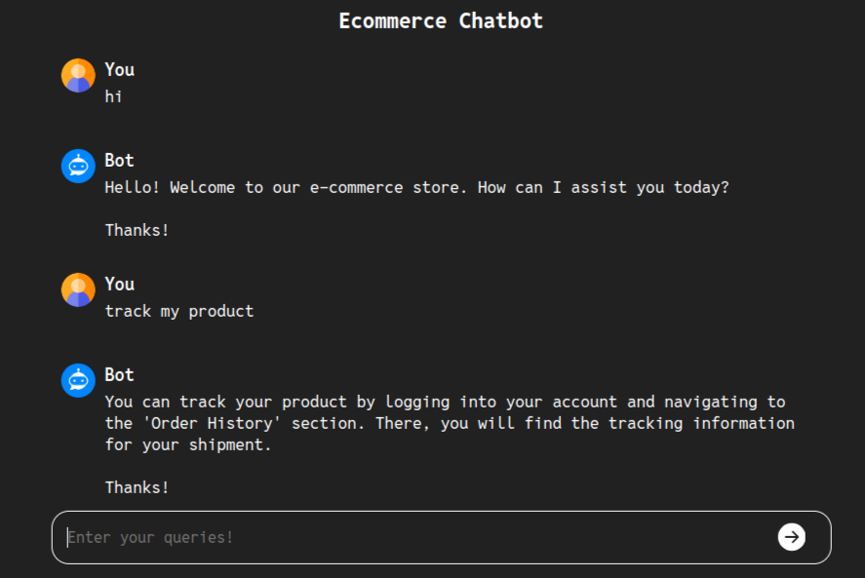
RESULT
RESULT
Implemented on Django

Slide 17
CONCLUSION
The chatbot code is hosted on GitHub by implementing the main code directly on a Jupyter Notebook. This approach allows for easy viewing and execution of the code.Our eCommerce chatbot leverages advanced AI to deliver personalized customer support, enhancing the shopping experience and providing a competitive edge in the digital marketplace. As AI technologies continue to advance, our chatbot is poised to evolve and offer even more innovative solutions to meet the changing demands of the eCommerce industry.

Slide 18
REFERENCES
NumPy: https://numpy.org/
TensorFlow: https://www.tensorflow.org/
Keras: https://keras.io/
scikit-learn (sklearn): https://scikit-learn.org/stable/
Keras Tuner: https://keras.io/keras_tuner/
NLTK (Natural Language Toolkit): https://www.nltk.org/
Django: https://www.djangoproject.com/
Pickle (Python's standard library): https://docs.python.org/3/library/pickle.html

